Slide 1
IN THE NAME OF GOD

Slide 2
Complications and treatment of children’s tracheobronchial foreign bodies
Dr. Farinaz Amiri Kar
pediatric pulmonologist

Slide 3
Complications associated with
tracheobronchial foreign bodies depend on:
the nature
size
shape
duration of impaction of the foreign body.
Sometimes aspirated foreign bodies can be completely asymptomatic initially and present later with complications of retained foreign body.

Slide 4
Chronic Cough
Recurrent / persistent “croup”
Poorly controlled “asthma”
Recurrent pneumonia

Slide 5
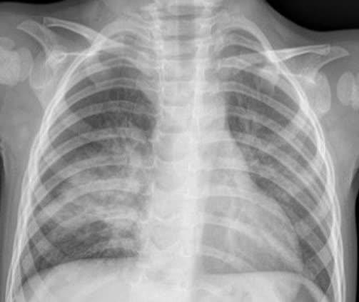
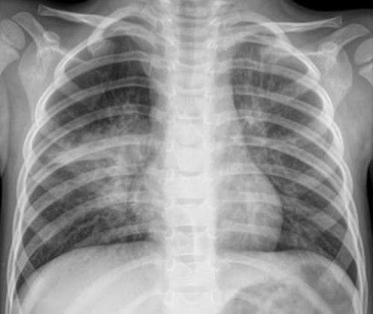
Recurrent pneumonia

Slide 6
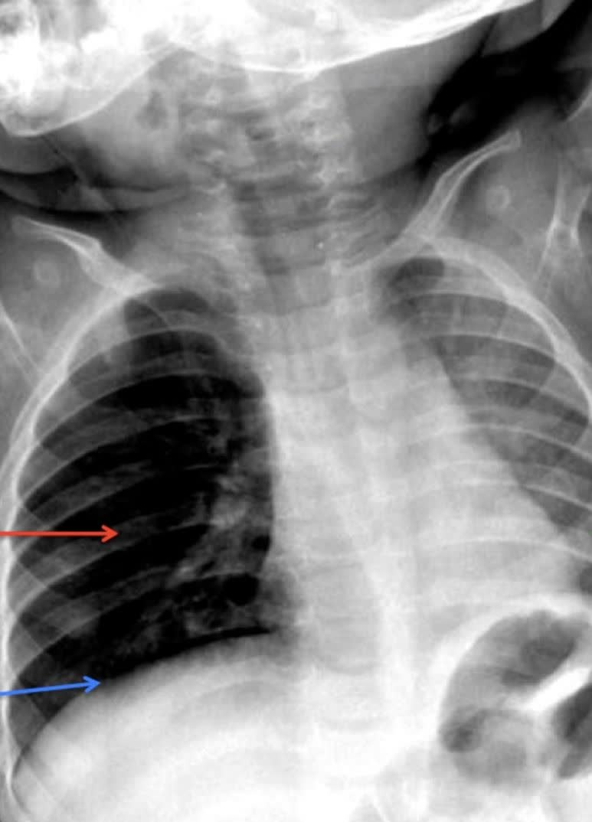
Pneumothorax

Slide 7
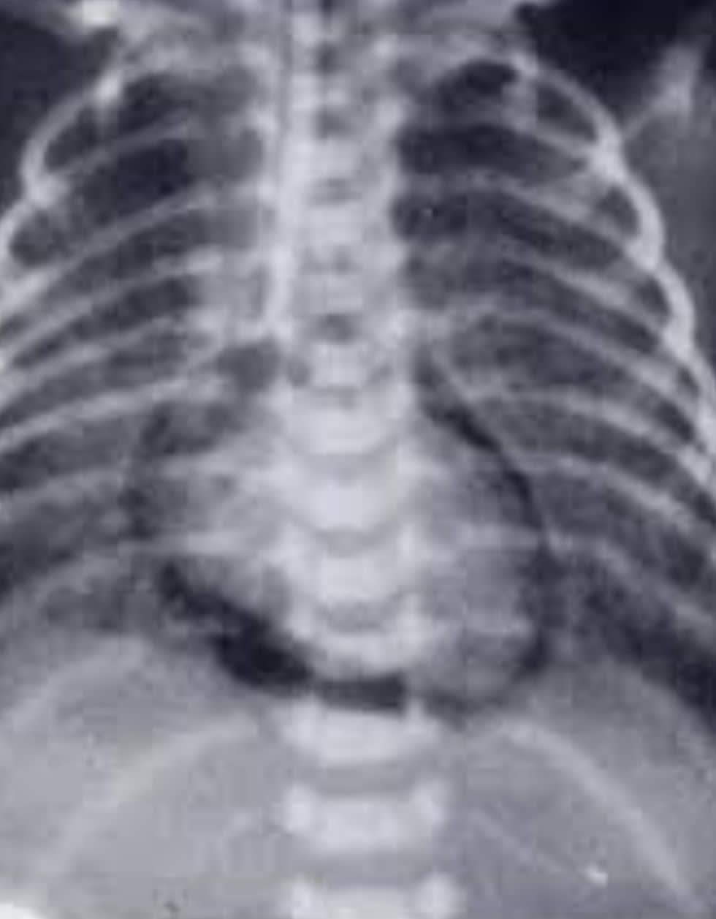
pneumomediastinum

Slide 8
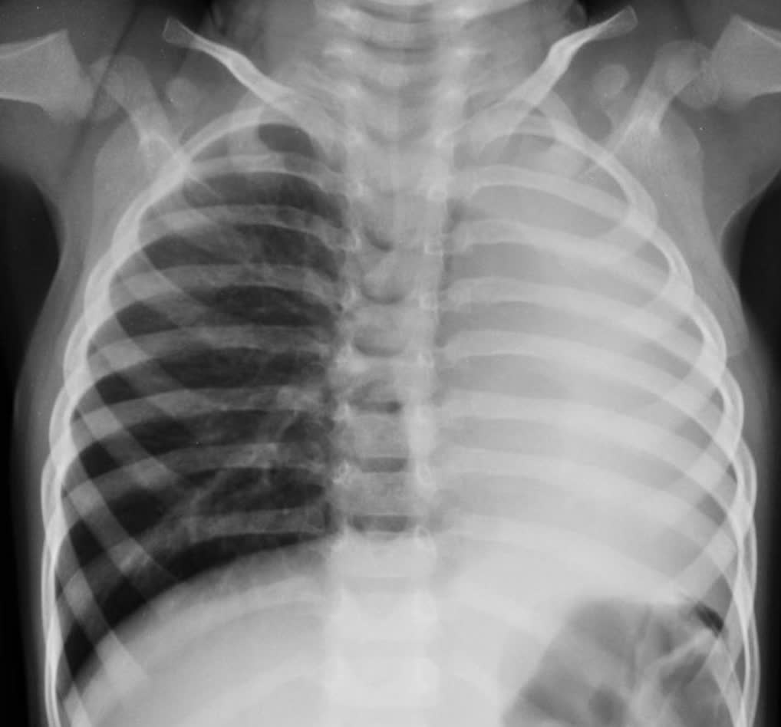
lobar collapse

Slide 9
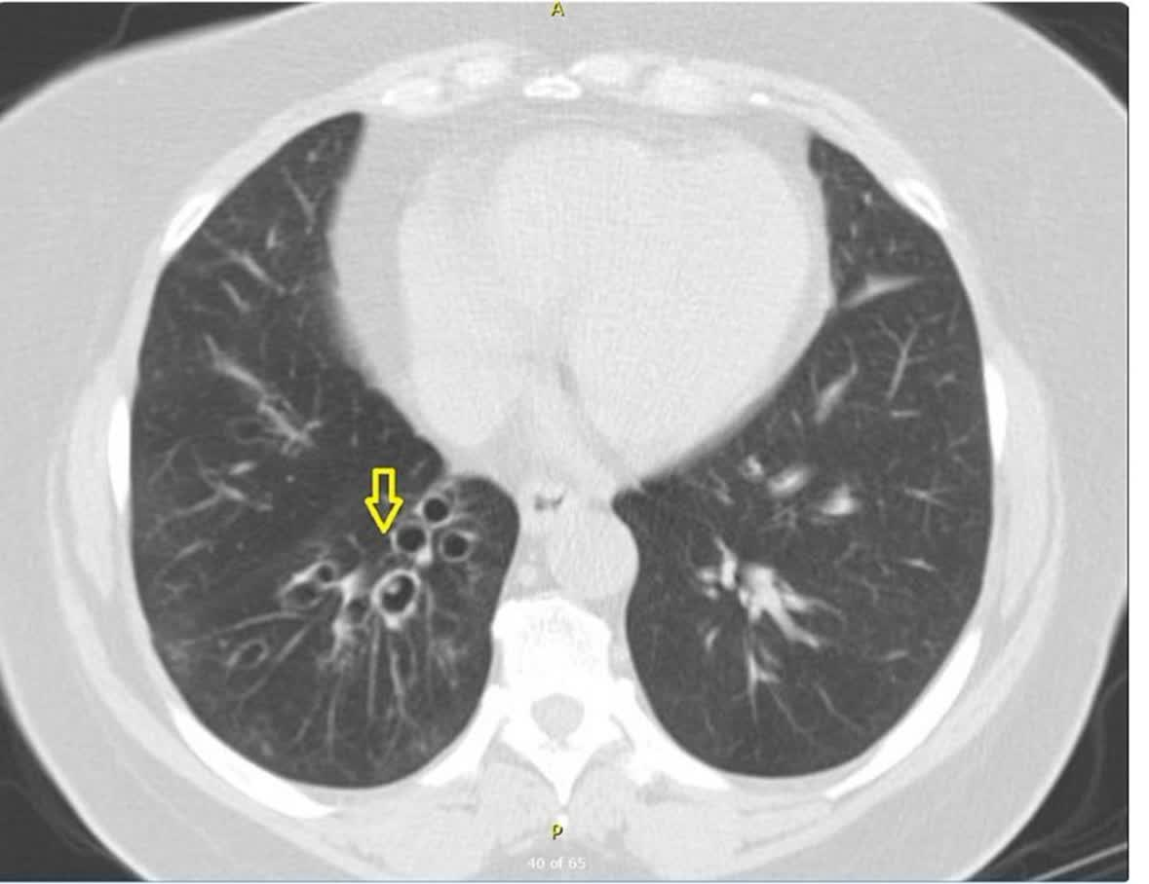
bronchiectasis

Slide 10
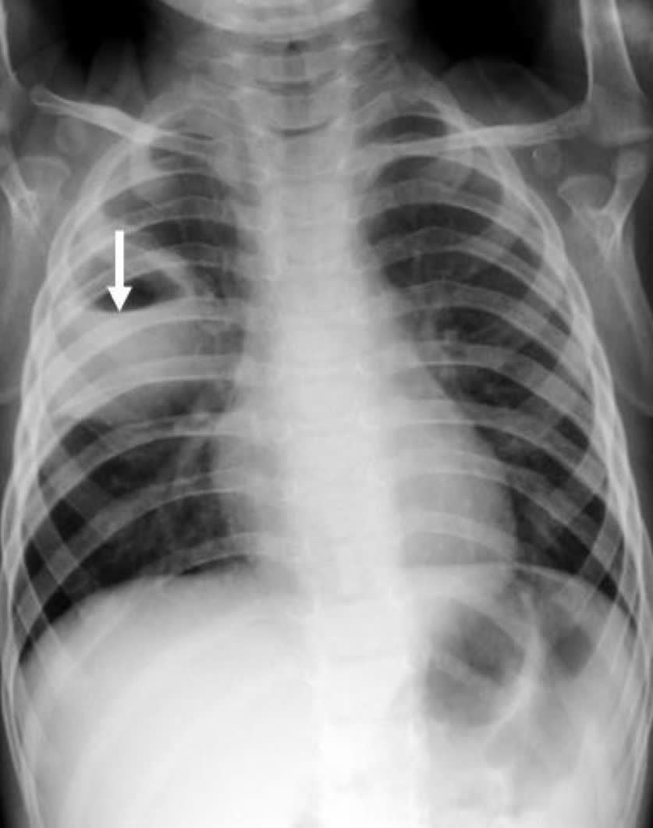
Lung Abscess

Slide 11
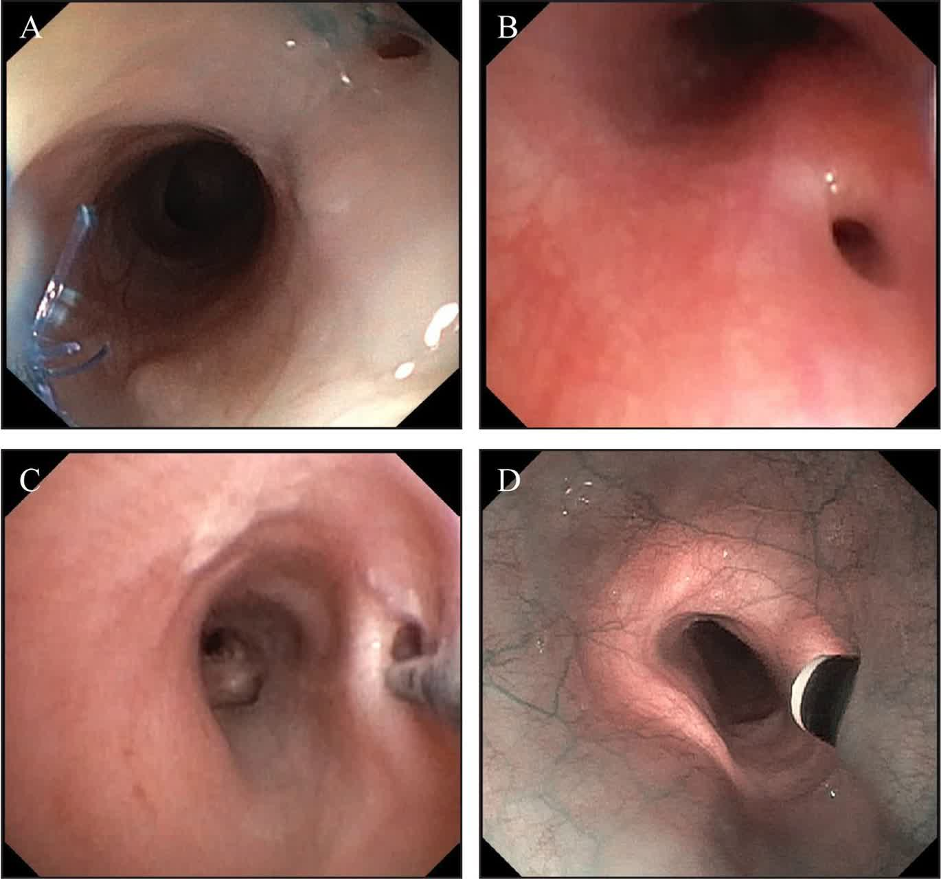
Broncho-esophageal fistula

Slide 12
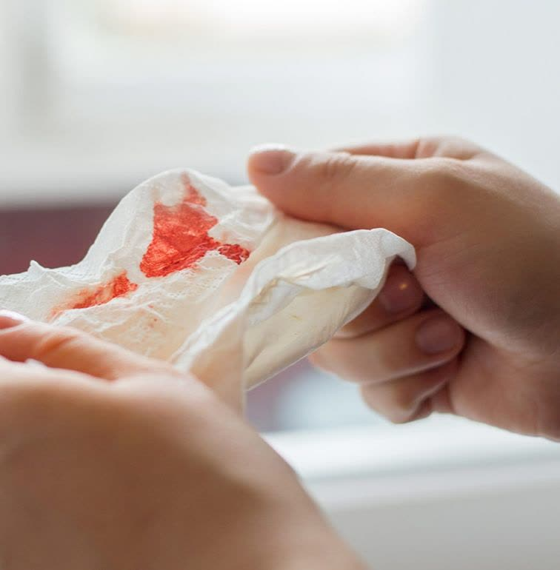
Hemoptysis

Slide 13
Treatment

Slide 14
gold-standard rigid bronchoscopy

Slide 15
Sometimes the child requires antibiotics, steroids or inhaled bronchodilators for a brief period of time after a foreign body is removed from the airway.

Slide 16
THE END.

